Slide 1

Institute of Technology, Nirma University Sarkhej - Gandhinagar Hwy, Gota, Ahmedabad, Gujarat 382481
“Implementing of Blockchain for Personal Data”
In partial fulfillment of
Master of Computer Application
(MCA PROGRAMME)
2019-2022
Major project
Under the Guidance of: | Submitted by:
Prof. Devendra Vashi | Yash Sompura 19MCA067

Slide 2
Acknowledgment
I would like to express my gratitude to Dr. Devendrasinh Vashi (Department of Master of Computer Application) for his unwavering and unbiased support during the whole research and development time, as well as for guiding me throughout the Major project phase. They created a conducive climate for me; without them, I would not have been able to attain my goal. Despite their busy schedules, they were always there for me and a fantastic source of inspiration. They were widely accessible both during and after college hours. That is something for which I am grateful.
I would also like to extend my gratitude to our Head of department Ma’am Dr. Madhuri Bhavsar and our Director Sir Dr. R. N. Patel for providing me with all the facilities that were required to complete this project.
I feel a mixture of appreciation, delight, and tremendous satisfaction as I express my gratitude to all individuals who have contributed directly or indirectly to the project’s successful completion.

Slide 3
Project Scope
As we all know, the future of block chain technology is mostly in the sector of cybersecurity. Furthermore, despite the fact that the block chain is open source, it nevertheless manages to keep data private through the use of security settings and verifiers. Data is encrypted to eliminate risks from unwanted data tampering and to avoid data breaches to a large extent. When it comes to personal data on the block chain, data privacy is critical, as data leakage is unacceptably dangerous for private information. The hashed data hides the original information. However, the hash of the block protects the block from attack, giving the data double security. This sort of security mechanism is being considered in the project in order to make data transfer very safe for personal data via peer-to-peer transmission.

Slide 4
Objective
The goal of the block chain for personal data is to allow for the distribution and storage of information while preventing unauthorized editing. As a result, the block chain created is immutable and irreversible, as the completed transactions are neither deleted or changed. Because this block chain is for private data, there is a system in place to ensure that the data or hashed data (which is irreversible) is never erased. Because the data is hashed and the block is hashed, the chain has double security, making the data safe and indestructible to attackers. This aids the block chain’s passive security once again.

Slide 5
Tools of Project
FRONT-END
HTML:- The coding used to organize a webpage and its content is known as HTML. HTML is widely used to format web pages utilizing the language's many tags. If you know HTML well, you can edit an existing web template to build a website.
Bootstrap:- Bootstrap is a popular front-end tool for building cutting-edge websites and apps. It's free and open source, and its main goal is How use the color, size, font, and layout options in Bootstrap to a web project.
Back-End
Python 3.8 version (Py-charm: 2022.1):- Python is a high-level, interactive, and object-oriented scripting language. We have use Python for back-end purpose in this we get easily inbuilt Libraries for user needs. Python operates on a wide range of hardware platforms and offers a consistent user interface.
Flask:- Python-based Flask is a micro-web development framework. Flask is a simple and lightweight Python framework for web development. It provides developers more dynamic and is therefore new developers more easy accessibility because You may easily create a web application and fast with only one single python file.

Slide 6
Introduction of the Block chain
A block chain is a distributed database, which means that the database's storage devices aren't all connected to the same Computer system. It keeps track of a growing set of organized records known as blocks. A date and a timestamp are to be connected with each block of previous block.
A block chain is a collection of data-storing blocks. Santoshi Nakamoto created block chain in 1991. A block chain is a publicly accessible ledger. After data has been placed in a block chain, it is exceedingly impossible to change it. Block chain is a distributed database with qualities such as decentralization , traceability, non-tamper-ability, security, and reliability.
Block chain, is a representation of a database with a large number of users, keeps all transaction information on the block chain, which has stringent security standards. Block chain is a peer-to-peer independent network. There is no requirement for nodes to trust one another, There is also no primary node. As a result, transactions on the block chain must protect the confidentiality of transaction information through insecure networks while simultaneously maintaining transaction integrity.

Slide 7
Problem statement
For to store digital data/Record for security it requires block chain expertise to update. More hard to handle. Overcome to this problem block chain for personal data comes into picture, in this we can store data into the block chain with hiding important details for security of the user with the Masking method with its timestamp, date, hash data or encrypt data of the blocks.

Slide 8
Modules of the project
Transaction: - In this project the transaction function to initialize new transaction of data of our block chain. On-chain transactions occur in a block chain update after being validated or authorized.
Proof of Work: - This method will be used to confirm the transaction, produce additional blocks in the chain, and compete against one another to finish the network transaction.
Consensus method: - we have used this function to verify or check in proof of work that the chain has been replaced or not of data.
Administration: - In this we have developed a UI for the block chain.

Slide 9
Full chain: - In this it will show the all transaction of the chain with its timestamp, full block hashed data, date, node etc.
Last block: - In this it will allow to create the data with the last block with its hash key.
Data Allowance: - In our project the data allowance is used for to check the datatypes of the row which user selected (STR, INT, Float) for respective hidden columns.
Security: - For the security we have used SHA-256 for to create a hashed data or encrypt data of all row in the column and also we have created a particular encrypt data for the whole single block.
Masking: - we have done masking when the user selects the particular columns from the check box it will hide the data in the blocks.
Data set: In this we have created dynamic data for CSV formats. So we can add any of the data set of CSV for data input into the blocks of block chain.

Slide 10
Parameters: Node latency, Block chain scalability, Transaction and Consensus, Centralization
Author | Year | Parameters comparison |  |  |  | Key Contributions
 |  | 1 | 2 | 3 | 4
Angraal et al. | 2017 | N | Y | Y | Y | The security of block chain transactions and scalability for decentralized systems is challenging to achieve.
Crosby et al. | 2015 | N | Y | Y | Y | For a decentralized or partially centralized block chain, distributed consensus will revolutionize our digital world.
Garry Gibson | 2020 | Y | Y | N | Y | Data transfer utilizing secure block chain (bitcoin's block chain) in a peer-to-peer format at a low cost.
Dansehgar et al. | 2018 | N | Y | Y | N | The block chain technique enables the hash value to be checked for security with distributed consensus and scalability for data transaction loads.
Marbouh et al. | 2020 | Y | Y | N | N | Every node on the block chain is required to keep all approved transactions, which presents a Because the block size and time interval asked to generate new blocks are restricted, this is a difficult task.
Proposed | 2022 | Y | Y | Y | Y | The centralized block chain with user end node latency accepts transaction that are in a queue for just user end node latency to be countable for any data set size.

Slide 11
Data Dictionary
Hidden data details
No. | Fieldname | Field type | Field size | Constraint | Description
1 | User_id | Int | 10 | Primary key, Auto Increment | Unique id for user
2 | Contact_no | Long Int | 10 | Not Null | User contact no
3 | Email_id | VARCHAR | 128 | Not Null, Foreign Key | Email of user
4 | Password | VARCHAR | 16 | Not Null | Password of user
5 | Account_no | VARCHAR2 | 64 | Not Null | Bank a/c no of user
6 | Address | VARCHAR2 | 256 |  | Address of the user
7 | Issued | Boolean | 2 | Not Null | sanction or not
8 | Cast | VARCHAR | 32 |  | Cast of the user

Slide 12
Displayed data details
No. | Fieldname | Field type | Field size | Constraint | Description
1 | Age | Int | 3 | Not Null | Age of the user
2 | Gender | VARCHAR | 16 | Not Null | Gender of the user male/female
3 | Cast | VARCHAR | 32 | Not Null | Cast of the user
4 | Marks | Int | 4 | Not Null | Marks obtained by the user
5 | Time | Timestamp | 8 | Not Null | Check the time
6 | IFSC code | Long Int | 128 | Not Null, Unique | IFSC code of user bank

Slide 13
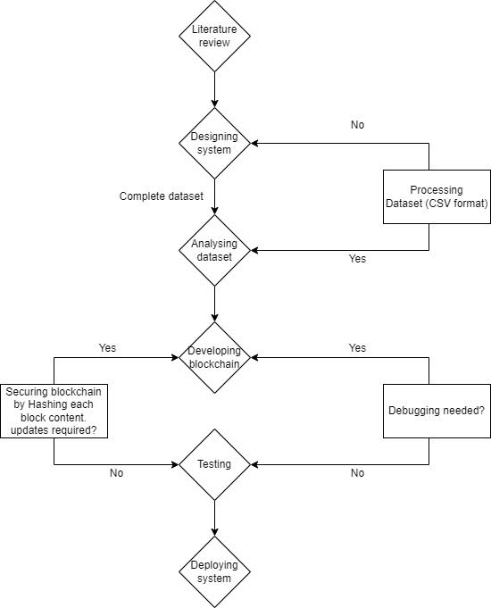
Flow Diagram

Slide 14
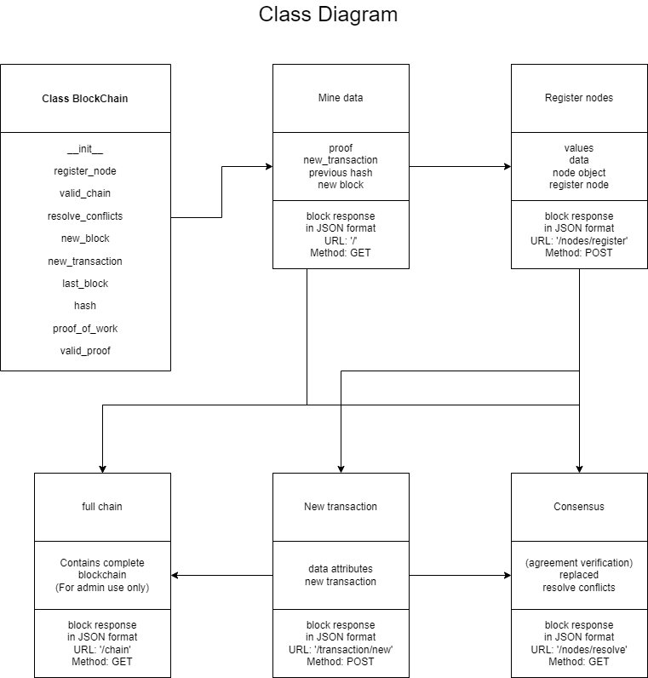

Slide 15
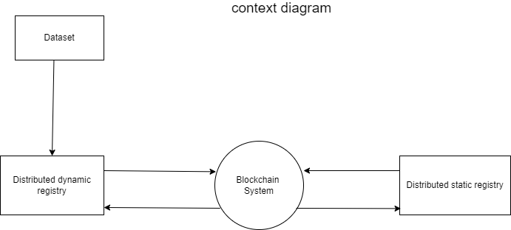

Slide 16
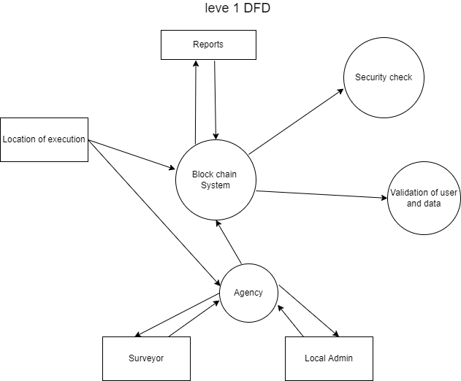

Slide 17
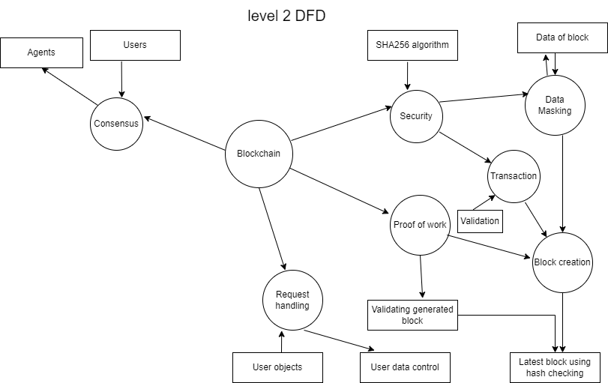

Slide 18
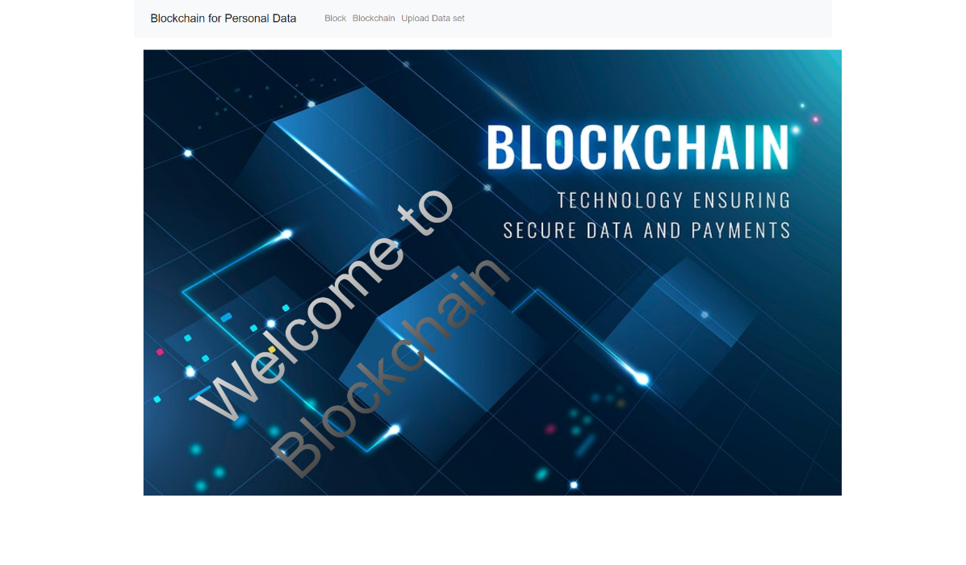
User manuals
Description: - This is our home page.

Slide 19
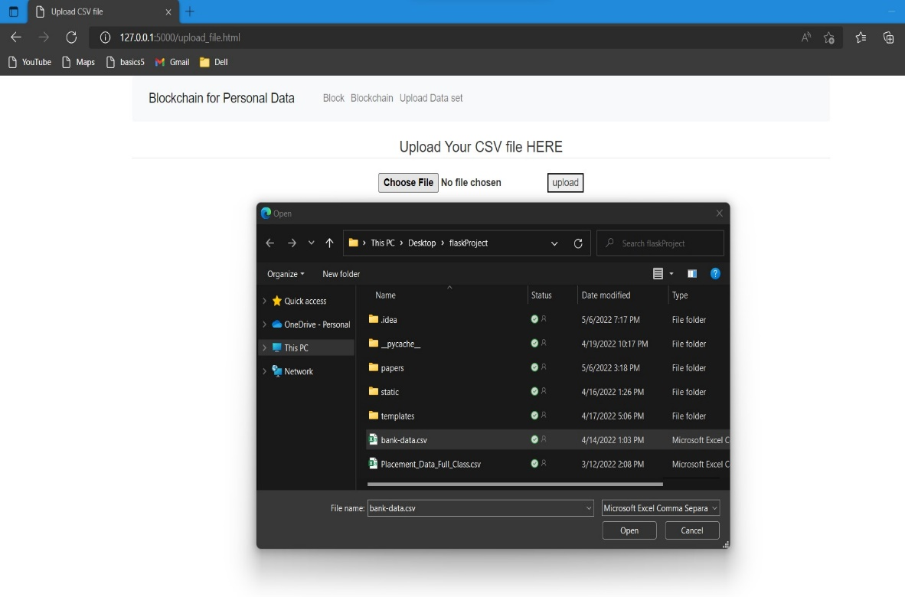
Description: - This is our data set page where you can upload Dataset from the drive.

Slide 20
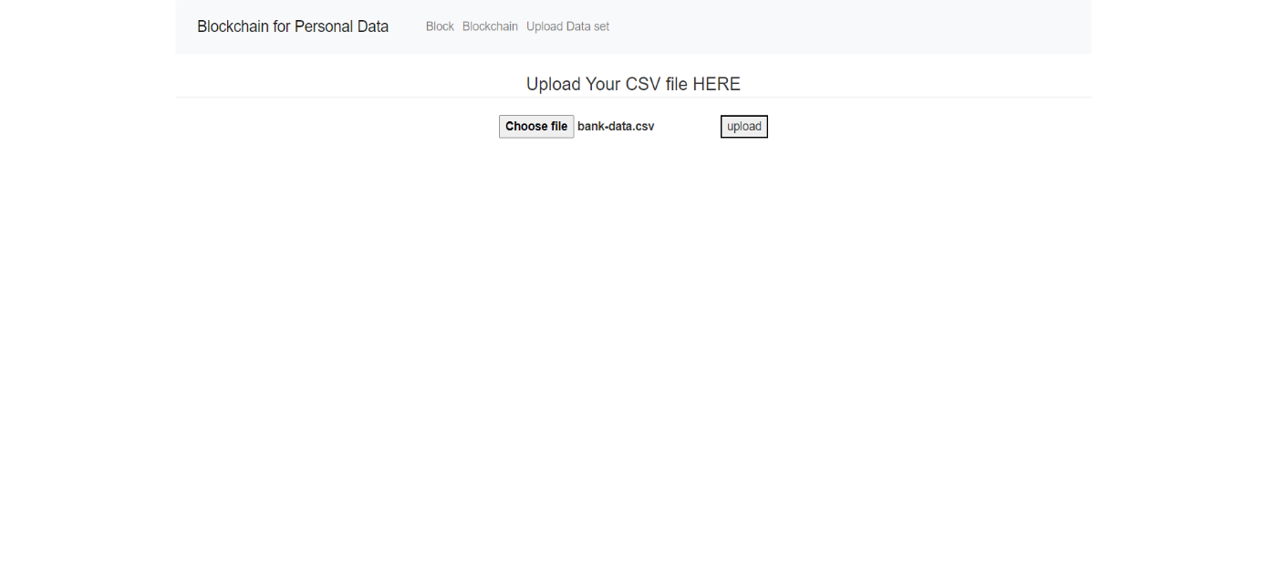
Description: - The data has been uploaded.

Slide 21
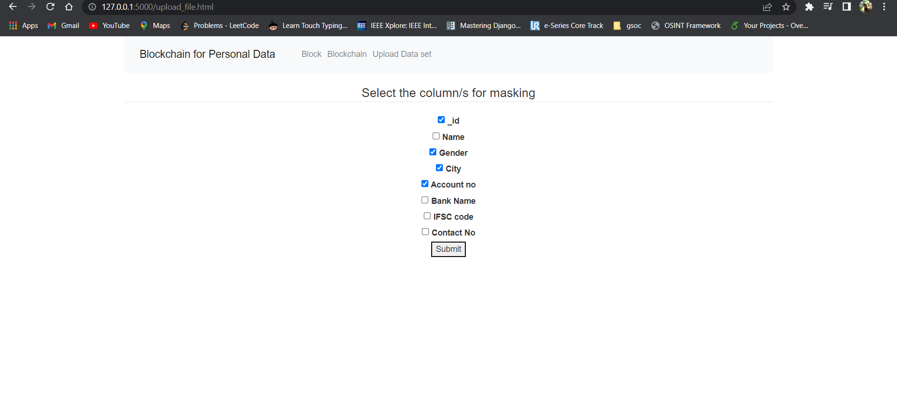
Description: - This is our Masking column’s from that you can hide the data into to block.

Slide 22
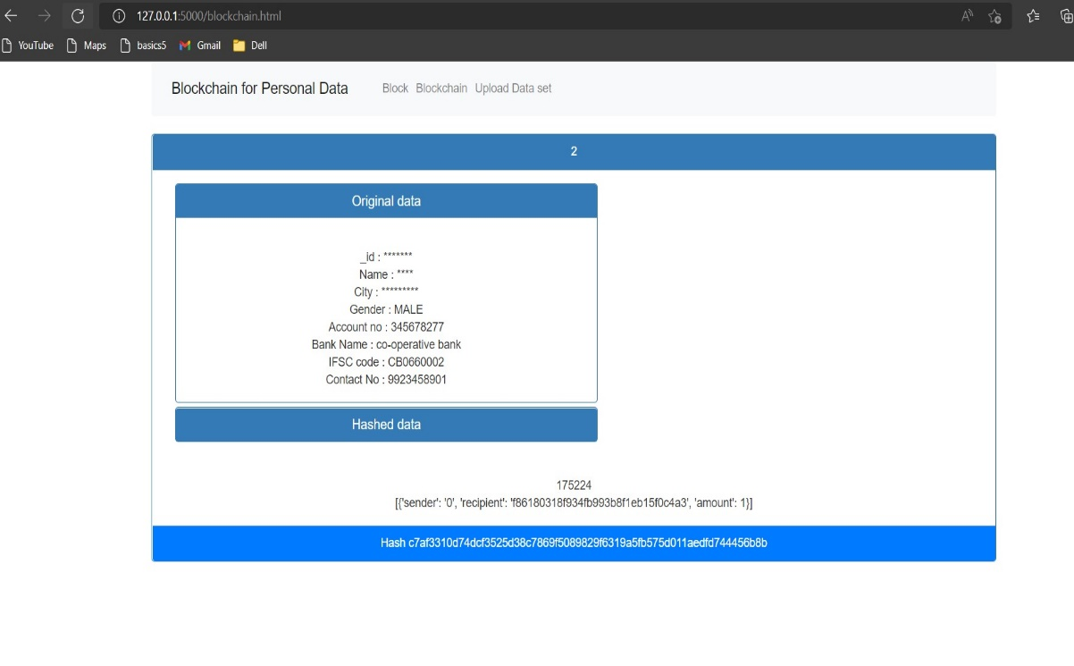
Description: - This is our block page in this it will creates the Blocks and showing our Masking columns and data with hiding our details.

Slide 23
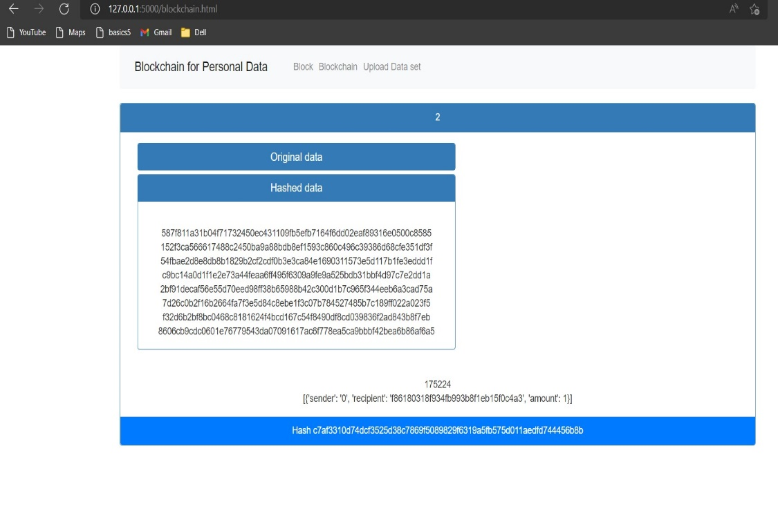
Description: - This is our hashed data of our original data and showing its particular hash key.

Slide 24
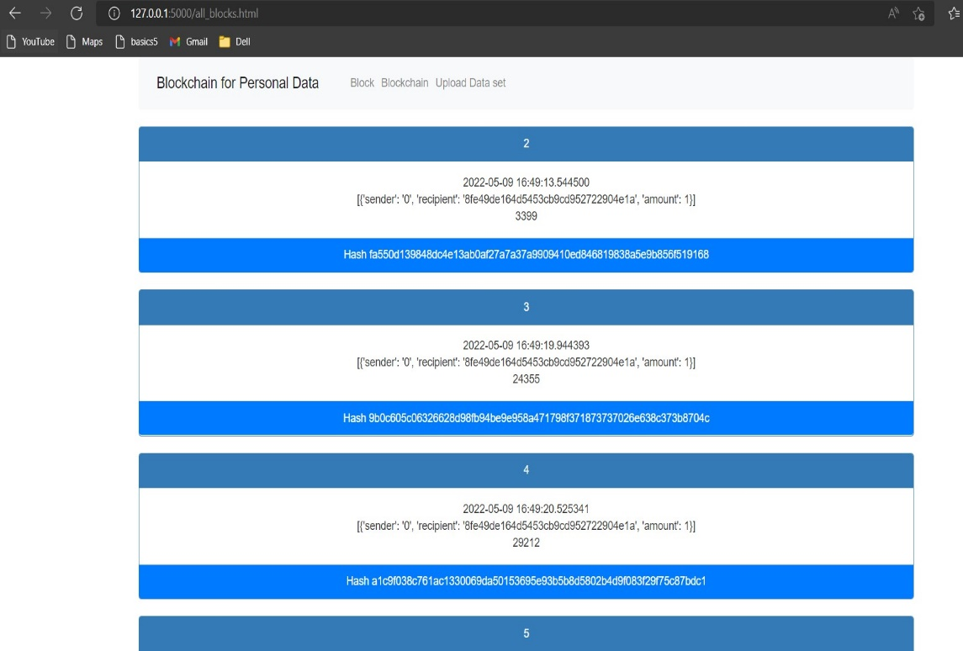
This is our full block chain with the date, timestamp, particular blocks hash key, node.

Slide 25
Conclusion
We have come to the conclusion that personal or sensitive data should not be given to other since they are sensitive to abuse and fraud. Users should instead be allowed to own and control their data while ensuring security. Our Platform enables the feature to store personal data dynamically and hiding Important details of the user in the block chain for user security. Furthermore, the block chain identifies the user as the data's owner. However, if a user has a significant volume of private data to store digitally for security, block chain for personal data is a chevalier choice.

